Slide 1
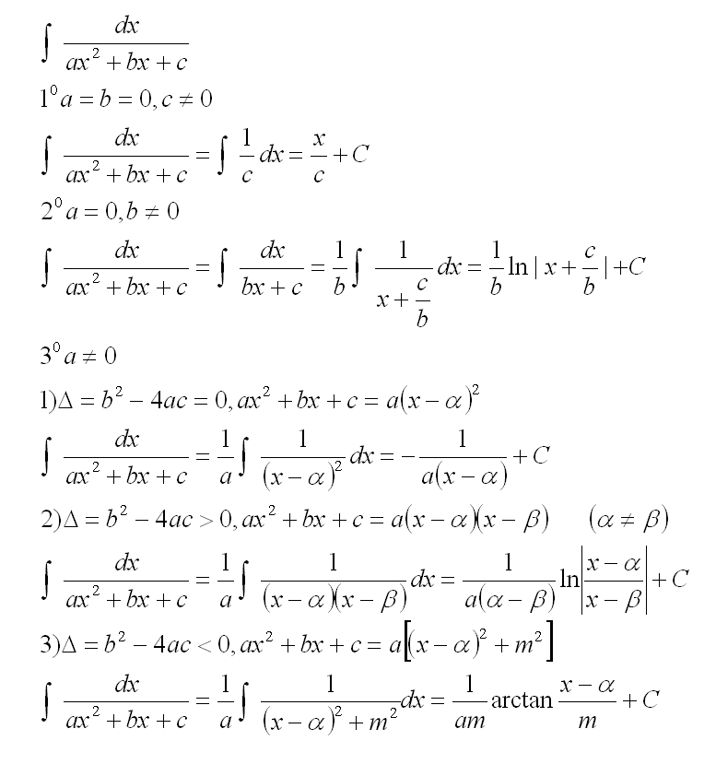
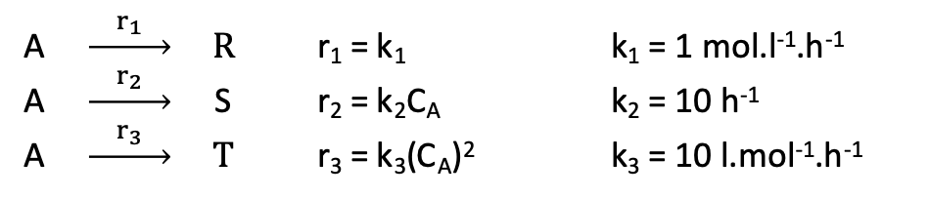

Yield optimisation
Solutions
A $\underset{→}{ r_{1} } R$ r₁ = k₁ k₁ = 1 mol.l⁻¹.h⁻¹
A $\underset{→}{ r_{2} }$ S r₂ = k₂C_{A} k₂ = 10 h⁻¹
A $\underset{→}{ r_{3} } T$ r₃ = k₃(C_{A})² k₃ = 10 l.mol⁻¹.h⁻¹
31) τ = 0,623 h
32) Y_{S/A} = 0,311
41) τ = 0,158 h
42) Y_{S/A} = 0,522
S is the desired product
C_{Ao} = 1 mol.l⁻¹
Isothermal reactor (50°C)
Constante density
51) CSTR+Plug Flow
52) τ = 0,225 h
53) Y_{S/A} = 0,564
7) $\frac{q}{F_{Ao}} = −13,77kcal.{mol}^{−1}$
8) T_{E} = 36,23°C

Slide 2
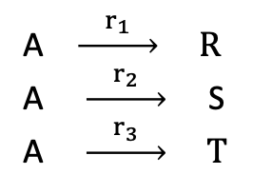
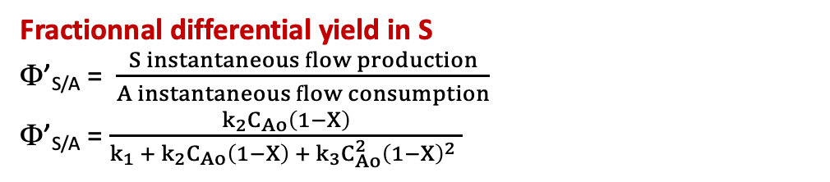
Yield optimisation
A $\underset{→}{ r_{1} } R$
A $\underset{→}{ r_{2} }$ S
A $\underset{→}{ r_{3} } T$
Rate of consumption of A
r = k₁ + k₂ C_{A} + k₃(C_{A})² Constante density: C_{A} = C_{Ao} (1-X)
r = k₁ + k₂ C_{Ao} (1-X) + k₃(C_{Ao})² (1-X)²
Fractionnal differential yield in S
Φ’_{S/A} = $\frac{S instantaneous flow production}{A instantaneous flow consumption}$
Φ’_{S/A} = $\frac{k_{2}C_{Ao}\left(1−X\right)}{k_{1} +{ k}_{2}C_{Ao}\left(1−X\right) +{ k}_{3}C_{Ao}^{2}{\left(1−X\right)}^{2} }$
A.N.: Φ’_{S/A} = $\frac{10×1×\left(1−X\right)}{1 +10×1×\left(1−X\right) +10×1^{2}×{\left(1−X\right)}^{2} }$ = $\frac{10\left(1−X\right)}{1 +10\left(1−X\right) +10{\left(1−X\right)}^{2} }$
Φ’_{S/A} is maximum for X = 0,684
So: Φ’_{S/A} = 0,613

Slide 3
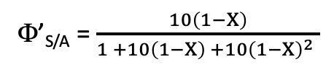
Yield optimisation
0,613
Φ’_{S/A} = $\frac{10\left(1−X\right)}{1 +10\left(1−X\right) +10{\left(1−X\right)}^{2} }$
0,684
X

Slide 4

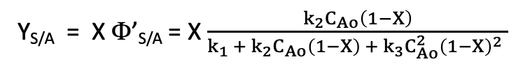
Yield optimisation
A $\underset{→}{ r_{1} } R$ r₁ = k₁ k₁ = 1 mol.l⁻¹.h⁻¹
A $\underset{→}{ r_{2} }$ S r₂ = k₂C_{A} k₂ = 10 h⁻¹
A $\underset{→}{ r_{3} } T$ r₃ = k₃(C_{A})² k₃ = 10 l.mol⁻¹.h⁻¹
Mass balance on A in a Continuous Stirred Tank Reactor (CSTR)
F_{Ao} - (k₁ + k₂ C_{A} + k₃(C_{A})²) V = F_{A} Constant density: C_{A} = C_{Ao} (1-X)
F_{Ao} – (k₁ + k₂ C_{Ao} (1-X) + k₃(C_{Ao})² (1-X)²) V = F_{Ao}(1-X)
C_{Ao}X = (k₁ + k₂ C_{Ao} (1-X) + k₃(C_{Ao})² (1-X)²) τ
τ = $\frac{C_{Ao}X}{k_{1} +{ k}_{2}C_{Ao}\left(1−X\right) +{ k}_{3}C_{Ao}^{2}{\left(1−X\right)}^{2} }$
τ = 0,623 h
Y_{S/A} = X Φ’_{S/A} = X $\frac{k_{2}C_{Ao}\left(1−X\right)}{k_{1} +{ k}_{2}C_{Ao}\left(1−X\right) +{ k}_{3}C_{Ao}^{2}{\left(1−X\right)}^{2} }$
Y_{S/A} = 0,311
X

Slide 5
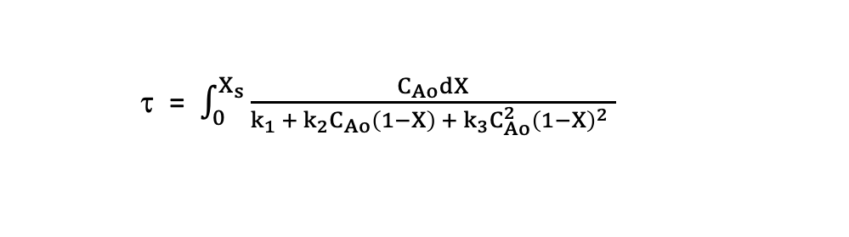
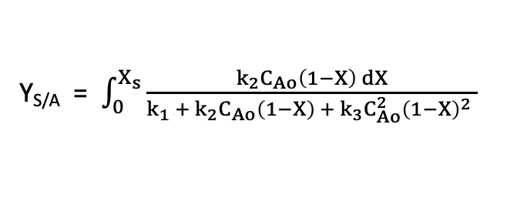
Yield optimisation
A $\underset{→}{ r_{1} } R$ r₁ = k₁ k₁ = 1 mol.l⁻¹.h⁻¹
A $\underset{→}{ r_{2} }$ S r₂ = k₂C_{A} k₂ = 10 h⁻¹
A $\underset{→}{ r_{3} } T$ r₃ = k₃(C_{A})² k₃ = 10 l.mol⁻¹.h⁻¹
Mass balance on A in a Plug Flow Reactor
F_{A} - (k₁ + k₂ C_{A} + k₃(C_{A})²) dV = F_{A} + dF_{A} Constant density: C_{A} = C_{Ao} (1-X)
(k₁ + k₂ C_{Ao} (1-X) + k₃(C_{Ao})² (1-X)²) dV = F_{Ao}dX
C_{Ao}dX = (k₁ + k₂ C_{Ao} (1-X) + k₃(C_{Ao})² (1-X)²) dτ
τ = $\int_{0}^{X_{s}}{\frac{C_{Ao}dX}{k_{1} +{ k}_{2}C_{Ao}\left(1−X\right) +{ k}_{3}C_{Ao}^{2}{\left(1−X\right)}^{2} }}$
τ = 0,158 h
Y_{S/A} = $\int_{0}^{X_{s}}{\frac{k_{2}C_{Ao}\left(1−X\right) dX}{k_{1} +{ k}_{2}C_{Ao}\left(1−X\right) +{ k}_{3}C_{Ao}^{2}{\left(1−X\right)}^{2} }}$
Y_{S/A} = 0,522
X

Slide 6
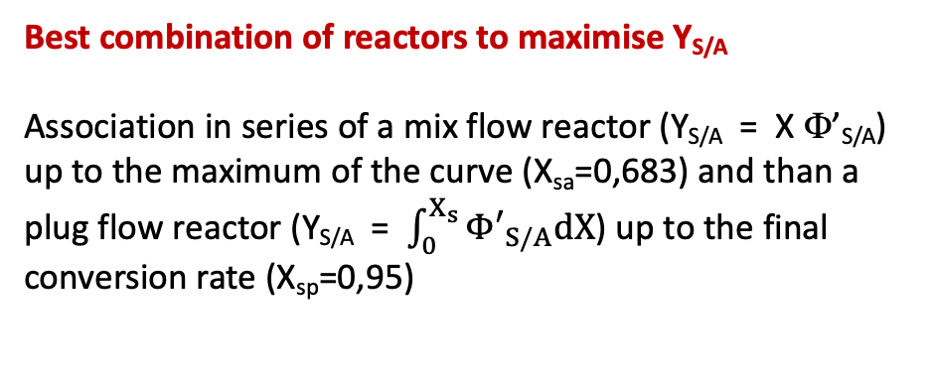
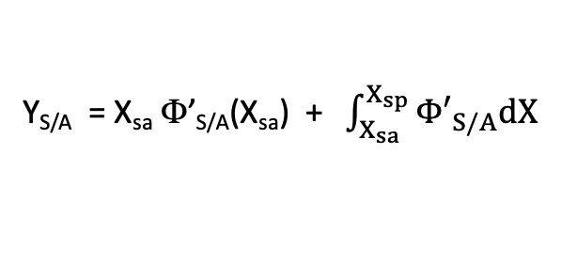
Yield optimisation
Best combination of reactors to maximise Y_{S/A}
Association in series of a mix flow reactor (Y_{S/A} = X Φ’_{S/A}) up to the maximum of the curve (X_{sa}=0,683) and than a plug flow reactor (Y_{S/A} = $\int_{0}^{X_{s}}{{Φ′}_{S/A}dX}$) up to the final conversion rate (X_{sp}=0,95)
τ_{a} = 0,133 h
τ_{p} = 0,093 h
τ = τ_{a} + τ_{p} = 0,225 h
Y_{S/A} = X_{sa} Φ’_{S/A}(X_{sa}) + $\int_{X_{sa}}^{X_{sp}}{{Φ′}_{S/A}dX}$
Y_{S/A} = 0,564
X

Slide 7



Yield optimisation
Mass balance on A in the first tank in series
F_{Ao} – (k₁ + k₂ C_{Ao} (1-X₁) + k₃(C_{Ao})² (1-X₁)²) V = F_{Ao}(1-X₁)
C_{Ao}X₁ = (k₁ + k₂ C_{Ao} (1-X₁) + k₃(C_{Ao})² (1-X₁)²) τ
X₁ = 0,314
Φ’_{S/A1} = 0,546
Y_{S/A1} = 0,171
τ = $\frac{C_{Ao}X_{1}}{k_{1} +{ k}_{2}C_{Ao}\left(1−X_{1}\right) +{ k}_{3}C_{Ao}^{2}{\left(1−X_{1}\right)}^{2} }$
Mass balance on A in the second tank in series
F_{A1} – (k₁ + k₂ C_{Ao} (1-X₂) + k₃(C_{Ao})² (1-X₂)²) V = F_{Ao}(1-X₂)
C_{Ao} (X₂-X₁) = (k₁ + k₂ C_{Ao} (1-X₂) + k₃(C_{Ao})² (1-X₂)²) τ
X₂ = 0,518
Φ’_{S/A2} = 0,592
Y_{S/A2} = 0,292
τ = $\frac{C_{Ao}\left(X_{2}−X_{1}\right)}{k_{1} +{ k}_{2}C_{Ao}\left(1−X_{2}\right) +{ k}_{3}C_{Ao}^{2}{\left(1−X_{2}\right)}^{2} }$
X₃ = 0,658
Φ’_{S/A3} = 0,612
Y_{S/A3} = 0,378
Mass balance on A in the third tank in series
C_{Ao} (X₃-X₂) = (k₁ + k₂ C_{Ao} (1-X₃) + k₃(C_{Ao})² (1-X₃)²) τ
τ = $\frac{C_{Ao}\left(X_{3}−X_{2}\right)}{k_{1} +{ k}_{2}C_{Ao}\left(1−X_{3}\right) +{ k}_{3}C_{Ao}^{2}{\left(1−X_{3}\right)}^{2} }$

Slide 8

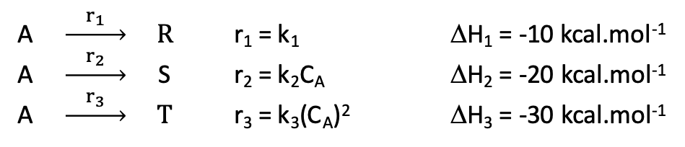
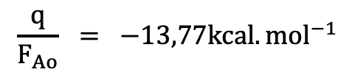
Yield optimisation
A $\underset{→}{ r_{1} } R$ r₁ = k₁ ΔH₁ = -10 kcal.mol⁻¹
A $\underset{→}{ r_{2} }$ S r₂ = k₂C_{A} ΔH₂ = -20 kcal.mol⁻¹
A $\underset{→}{ r_{3} } T$ r₃ = k₃(C_{A})² ΔH₃ = -30 kcal.mol⁻¹
Réacteur parfaitement agité continu
Réacteur isotherme (50°C)
Fonctionnement à l’optimum de Φ’_{S/A}
⇒ X = 0,683 et τ = 0,133h
Bilan thermique en réacteur parfaitement agité continu isotherme
q = (r₁ ΔH₁ + r₂ ΔH₂ + r₃ ΔH₃) V + 0
Puissance reçue chaleur absorbée Echauffement du
par le système par les réactions mélange réactionnel
q = (k₁ ΔH₁ + k₂ C_{Ao} (1-X) ΔH₂ + k₃(C_{Ao})² (1-X)² ΔH₃) V
$\frac{q}{F_{Ao}} =$ $\left[\frac{k_{1}}{C_{Ao}}\text{D}\text{H}\text{1}\text{ + }\text{k}\text{2}\text{ (1−}\text{X}\text{) }\text{D}\text{H}\text{2}\text{ + }\text{k}\text{3}\text{C}\text{Ao}\text{(1−}\text{X}\text{)2 }\text{D}\text{H}\text{3}\text{)}\right]τ$
$$\frac{q}{F_{Ao}} = −13,77kcal.{mol}^{−1}$$

Slide 9

Yield optimisation
A $\underset{→}{ r_{1} } R$ r₁ = k₁ ΔH₁ = -10 kcal.mol⁻¹
A $\underset{→}{ r_{2} }$ S r₂ = k₂C_{A} ΔH₂ = -20 kcal.mol⁻¹
A $\underset{→}{ r_{3} } T$ r₃ = k₃(C_{A})² ΔH₃ = -30 kcal.mol⁻¹
Réacteur parfaitement agité continu
Réacteur adiabatique (T_{s} = 50°C)
Fonctionnement à l’optimum de Φ’_{S/A}
⇒ X = 0,683 et τ = 0,133h
Bilan thermique en réacteur parfaitement agité continu adiabatique
0 = (r₁ ΔH₁ + r₂ ΔH₂ + r₃ ΔH₃) V + Q ρ Cp (T_{S}-T_{E})
Puissance reçue chaleur absorbée Echauffement du
par le système par les réactions mélange réactionnel
0 = (k₁ ΔH₁ + k₂ C_{Ao} (1-X) ΔH₂ + k₃(C_{Ao})² (1-X)² ΔH₃ ) τ + ρ Cp (T_{S}-T_{E})
$\text{T}\text{S}\text{−}\text{TE} =$ $\frac{τ}{ρCp}$ (k₁ ΔH₁ + k₂ C_{Ao} (1-X) ΔH₂ + k₃(C_{Ao})² (1-X)² ΔH₃ )
$\text{T}\text{S}\text{−}\text{TE} = 13,77°C$ ⇒ T_{E} = 36,23°C

